Slide 1
Class Tools
CS 201, Summer 2013

Slide 2
ADDITIONAL READING
Constructors & Destructors
  Chapter 7 of Pearson book
  http://www.learncpp.com/cpp-tutorial/85-constructors/
  http://www.cplusplus.com/doc/tutorial/classes/
  http://www.learncpp.com/cpp-tutorial/86-destructors/
Pass By Reference
  Chapter 7 of Pearson book
  http://www.learncpp.com/cpp-tutorial/73-passing-arguments-by-reference/

Slide 3
ADDITIONAL READING
Const
  http://www.learncpp.com/cpp-tutorial/28-constants/
  http://www.cplusplus.com/doc/tutorial/constants/
  http://www.learncpp.com/cpp-tutorial/810-const-class-objects-and-member-functions/
Static members
  Chapter 7 of Pearson book
  http://www.learncpp.com/cpp-tutorial/811-static-member-variables/

Slide 4
Constructors
In classes, we can define a constructor.
  Constructors are special functions that execute as soon as you create an instance of that class (ie, when you declare a variable of that class-type)
  You can overload constructors!
  When you declare a variable that is a class-type, you can pass arguments in.
  Constructors must share the same name as the class itself!

Slide 5
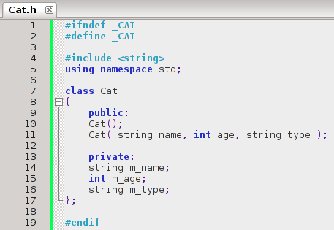
Constructors
Declaring two constructors – user can create a new Cat in two different ways.

Slide 6
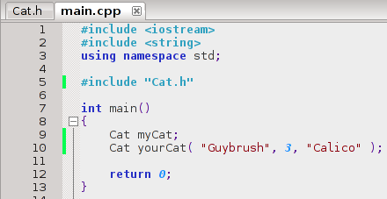
Constructors
Cat() constructor
Cat( string name, int age, string type ) constructor
A constructor can be used to initialize variables to “safe” defaults (ie, so we don't get undefined behavior and garbage)

Slide 7
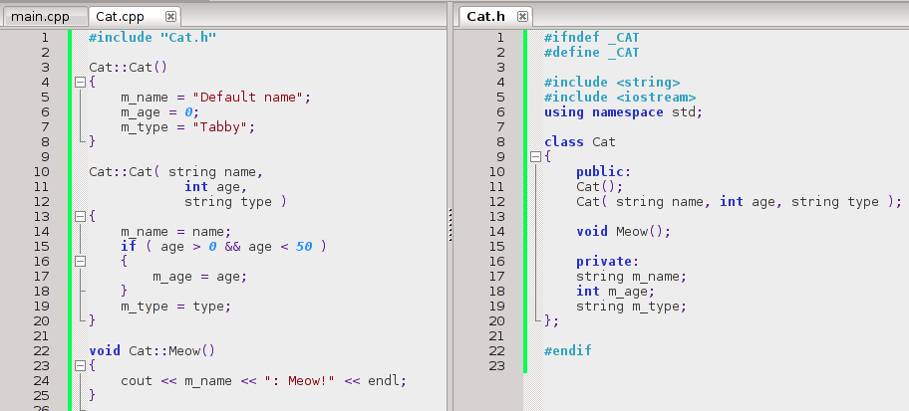
Constructors
Constructor definitions are similar to function definitions – except there's no return-type.

Slide 8
Default constructors
If you do not declare a constructor, a default constructor is automatically generated for you.
  It has no parameters, and initializes some variables to “safe” values (ie, no garbage).
If you declare any constructors, the default constructor isn't created.

Slide 9

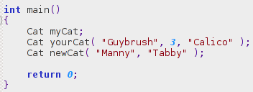
Constructor parameters
If your constructors all have parameters (no constructor with empty parameters), then when you create an instance of that class, you must pass in parameters.
Both constructors have parameters
There is no constructor without parameters; this will cause a compile-time error.

Slide 10
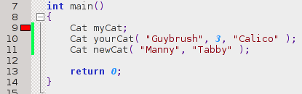
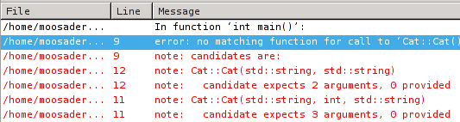
Constructor parameters
g++ compiler (Code::Blocks)
No matching candidates means that you're trying to call a function, but the arguments don't match up.

Slide 11
Destructors
Destructors are also special functions, like Constructors, except that they are run automatically when a variable falls out of scope.
You can use Destructors to free up memory.
  This will be more useful when we cover memory management, since you have to manually create and free memory here.

Slide 12
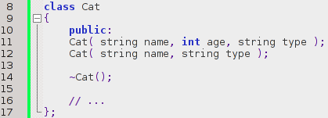
Destructors
Destructors also share the class' name, but are prefixed with a tilde (~).
  You cannot have parameters for the destructor
Destructor declaration

Slide 13
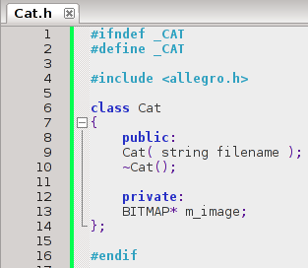
Destructors
If we were using the allegro library, we could create a BITMAP to load images.
With Allegro, you have to free the memory that held the image data afterward.

Slide 14
Destructors
We have a constructor that takes in a file name, to load the image file.
And a destructor that will free the image memory when a Cat variable is destroyed

Slide 15
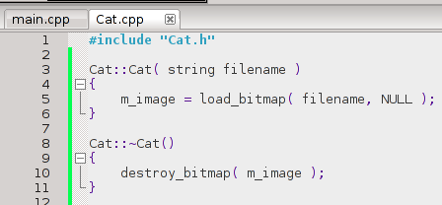
Destructors
Allegro has a function “load_bitmap”. When the class is initialized, we will load the image file into memory.
Allegro also has a function “destroy_bitmap”. When the variable is destroyed, we will make sure to destroy the image and free up memory.

Slide 16
Destructors
If we didn't free up memory, then every time we run the program it would keep allocating memory (ie, taking up memory) and never giving any memory back for other processes.
When this happens, it is called a memory leak.
If a function that allocates a lot of memory is called often in a program, you will be able to watch the memory on your computer shoot up (through the process monitor)
  I did this once for a map editor, it was ugly.
Of course, resetting the computer frees up memory.

Slide 17
Pass By Reference
Remember how arrays in C++ are automatically passed by reference?
  ie, most variables are passed by-value; a copy of them is made and stored in a different memory address.
  When passed by-value, a variable changed within a function won't affect the original variable passed as an argument.

Slide 18
Pass By Reference
Remember how arrays in C++ are automatically passed by reference?
  Arrays are passed by-reference because they could be potentially very large.
  Copying all the elements in an array could be expensive to memory and time.
  Therefore, they're automatically passed by-reference instead of by-value.

Slide 19
Pass By Reference
Classes face the same problem.
  A class may contain many variables, or even arrays. Copying them during a function call can be very expensive.
  We can explicitly pass something by-reference, rather than by-value.

Slide 20
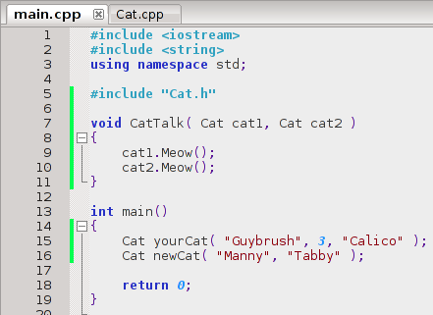
Pass By Value (default)
Usage:
Two Cat objects are passed in by-value; all of their members (name, age, type) are copied to new memory places.

Slide 21
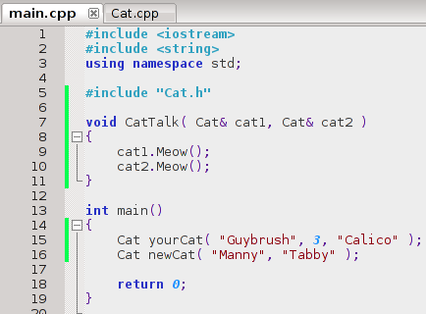
Pass By Reference
Usage: Add & to data-type
The ampersand (&) denotes “Reference”.
Here, it will pass a memory address instead.
Usage of the parameters remains the same.

Slide 22
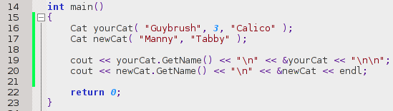
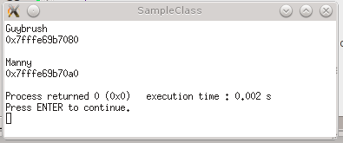
Pass By Reference
You can put a & before the variable name, and this will give you its memory address. & is the reference operator.

Slide 23
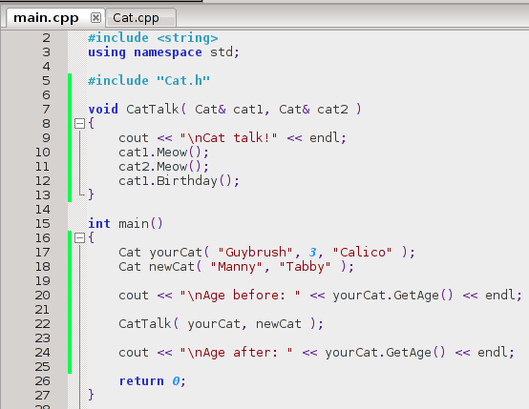
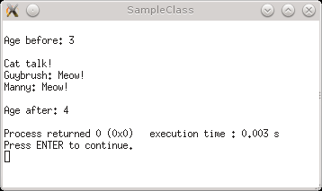
Pass By Reference
When passing by-reference, the variables can now be changed within the function, and keep that change at the calling level.
main() calls CatTalk, CatTalk changes a cat's age, and now in main() the cat's age is different.

Slide 24
Pass By Reference
The ability to change values in a variable passed by-reference could either be desired, or not...
C++ functions can only return one value, but with references we can return as many as we want – through the parameters themselves!
But if we want to pass a large object or array by-reference simply for efficiency, but don't want that function to change the values, we will need to use const.

Slide 25
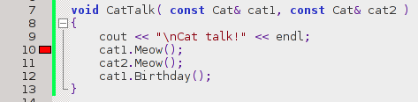

Pass By Reference
By adding const before the parameter's data-type, we ensure that the function will not be able to change anything, and simply just read data.
Trying to do otherwise will get you a compile error.

Slide 26

const
But – our Meow() function isn't changing anything! Why is the compiler complaining?
The problem is that we haven't explicitly told the compiler that this function won't change any of the class' data.
It isn't currently, but someone could come back to this function later, and add a line of code that changes a member of this class!
Therefore, we must explicitly tell C++ “hey – yeah this won't change anything. It's constant!”

Slide 27
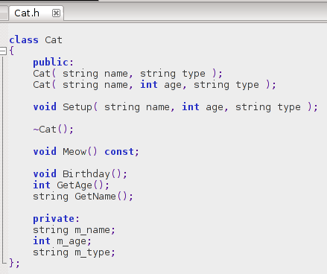
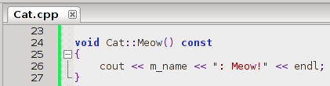
const
We can make the function explicitly const by adding the const keyword at the end of the function declaration and definition.
Now if we try to add code that will change something inside of Meow(), we'll get a compile error.
Remember:
Compiler errors are better than run-time errors because they're so much easier to find! The compiler will tell you!
Logic errors can be the worst bugs!
Whenever possible, try to design your program so you'll get compiler errors if something is done incorrectly!

Slide 28
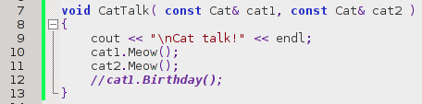
const
Now we can pass objects to a function by-reference, while also ensuring that the argument's data isn't changed by using the const keyword!

Slide 29

Static members
Finally, we can create static members in a class. These can be variables OR functions.
Usually when you create an instance of a class, each variable has its own data:
yourCat's private m_name variable is set to “Guybrush”.
newCat's private m_name variable is set to “Manny”.
Different Cat variables, each with their own, separate names.

Slide 30
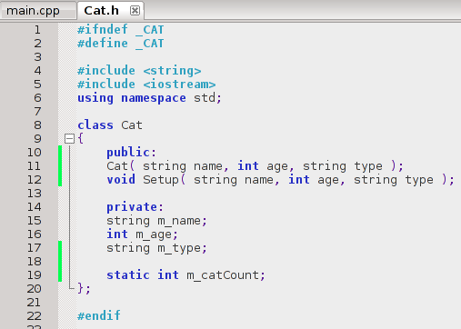
Static members
If we create a static member, then every instance of the class will share this variable and its value.
m_catCount will have the same value, no matter which instance of Cat you're accessing.

Slide 31
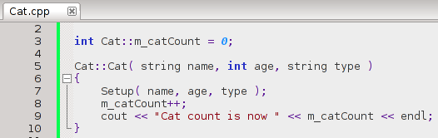
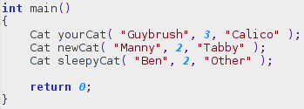
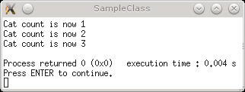
Static members
The static variable will need to be initialized in the .cpp file. Use the scope resolution operator (::) to reference the variable directly.
Every time the constructor is called, let's increment the static m_catCount by one.
Creating cats
Counter is correct since the variable is shared.

Slide 32
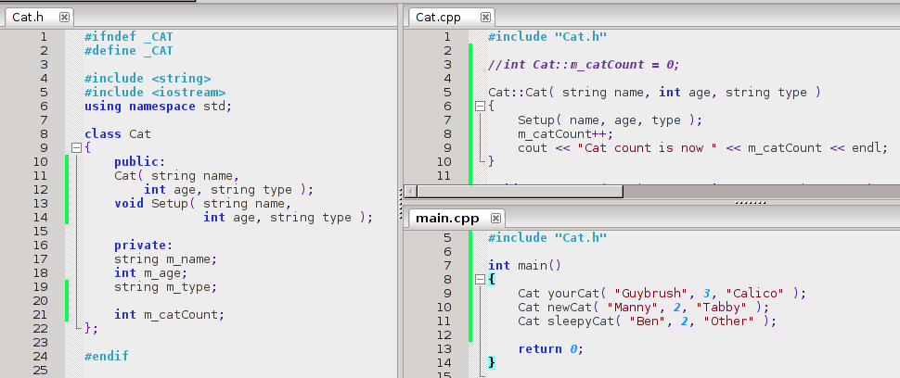
Static members
If m_catCount weren't static, each time we create a new Cat they would get their own m_catCount variable.
Removed static.

Slide 33
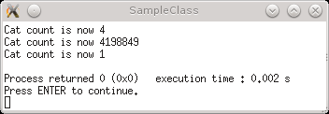
Static members
If m_catCount weren't static, each time we create a new Cat they would get their own m_catCount variable.
Each class' m_catCount variable has different values.
(Also, are populated with garbage because they didn't get initialized)

Slide 34
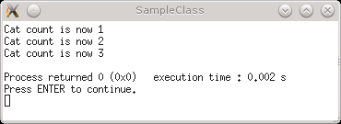
Static members
static counter
non-static counter
Increments each time
What else to use static members for?
  When you only need one instance of something that might be shared by the class.
  e.g., m_basePath that stores the base path to all the files we will need inside of a Document class. We only need to store the base path once, but each Document may need it to open a file.

Slide 35
Static members
What else to use static members for?
  Our Cat class (using Images) could keep a static list of images that have allocated memory, so it can also know which images to free.
  A “Graphics Manager” that holds all the graphics for a program. It stores a static array of graphics that can be accessed.

